Slide 1
Web Scrapping
What is Web scraping & How does it work.
Installation of Python and packages in Windows.
How to view HTML source code in Google Chrome.
Request Library for python for web scraping
How to parse HTML content using Beautiful Soup Library
How obtain HTML using BeautifulSoup

Slide 2
Requests Module
Requests library is used for making HTTP requests to a specific URL and returns the response. Python requests provide inbuilt functionalities for managing both the request and response.
Installation
pip install requests
Python requests module has several built-in methods to make HTTP requests to specified URI using GET, POST, PUT, PATCH, or HEAD requests. A HTTP request is meant to either retrieve data from a specified URI or to push data to a server. It works as a request-response protocol between a client and a server. Here we will be using the GET request.
GET method is used to retrieve information from the given server using a given URI. The GET method sends the encoded user information appended to the page request.

Slide 3
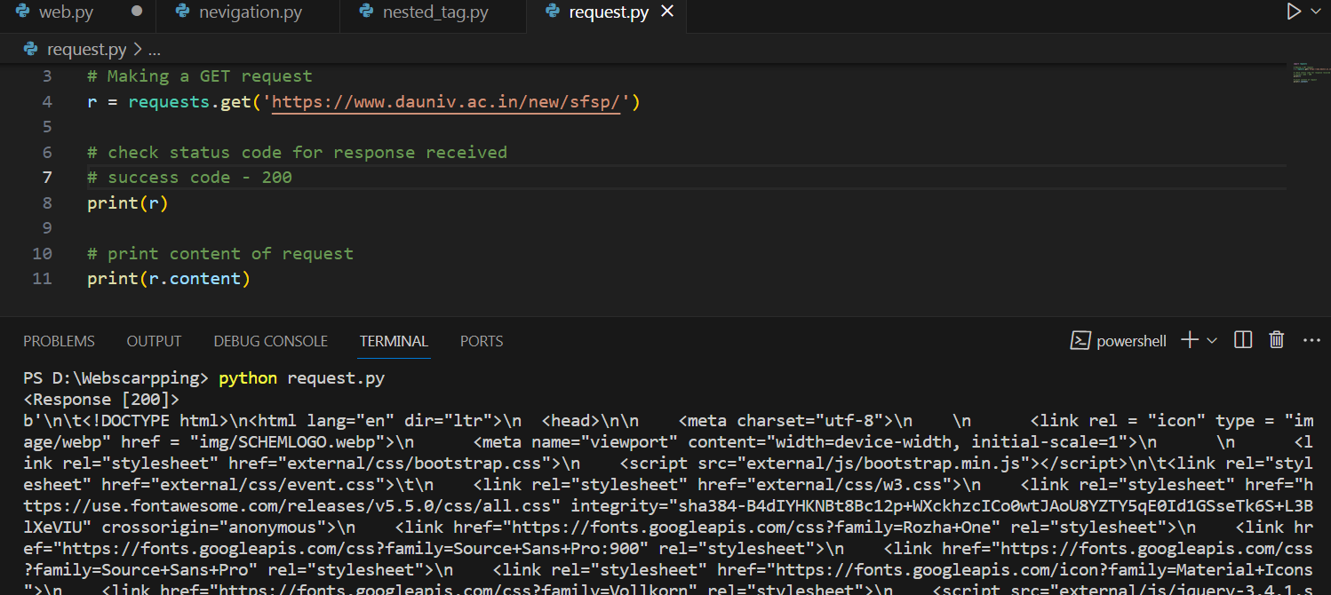

Slide 4
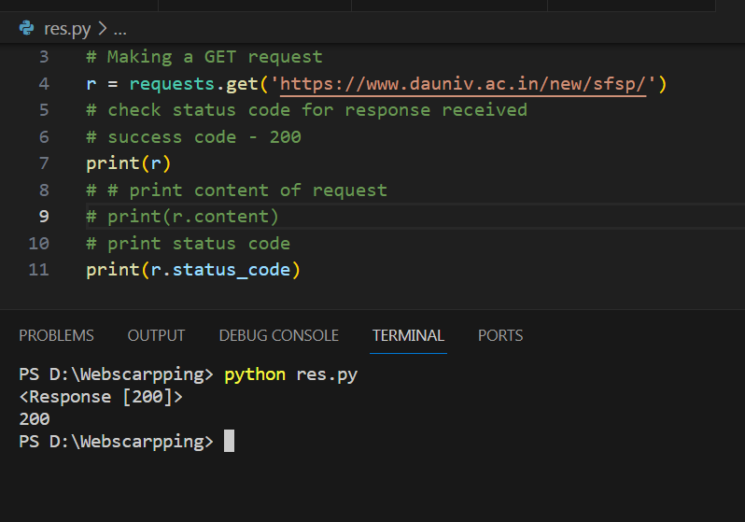
Response object
When one makes a request to a URI, it returns a response. This Response object in terms of python is returned by requests.method(), method being – get, post, put, etc. Response is a powerful object with lots of functions and attributes that assist in normalizing data or creating ideal portions of code. For example, response.status_code returns the status code from the headers itself, and one can check if the request was processed successfully or not.

Slide 5
BeautifulSoup Library
Installation
Features of Beautiful Soup
Beautiful Soup is a Python library developed for quick reversal projects like screen-scraping. Three features make it powerful:
1. Beautiful Soup provides a few simple methods and Pythonic phrases for guiding, searching, and changing a parse tree: a toolkit for studying a document and removing what you need. It doesn’t take much code to document an application.
2. Beautiful Soup automatically converts incoming records to Unicode and outgoing forms to UTF-8. You don’t have to think about encodings unless the document doesn’t define an encoding, and Beautiful Soup can’t catch one. Then you just have to choose the original encoding.
3. Beautiful Soup sits on top of famous Python parsers like LXML and HTML, allowing you to try different parsing strategies or trade speed for flexibility.
pip install beautifulsoup4

Slide 6
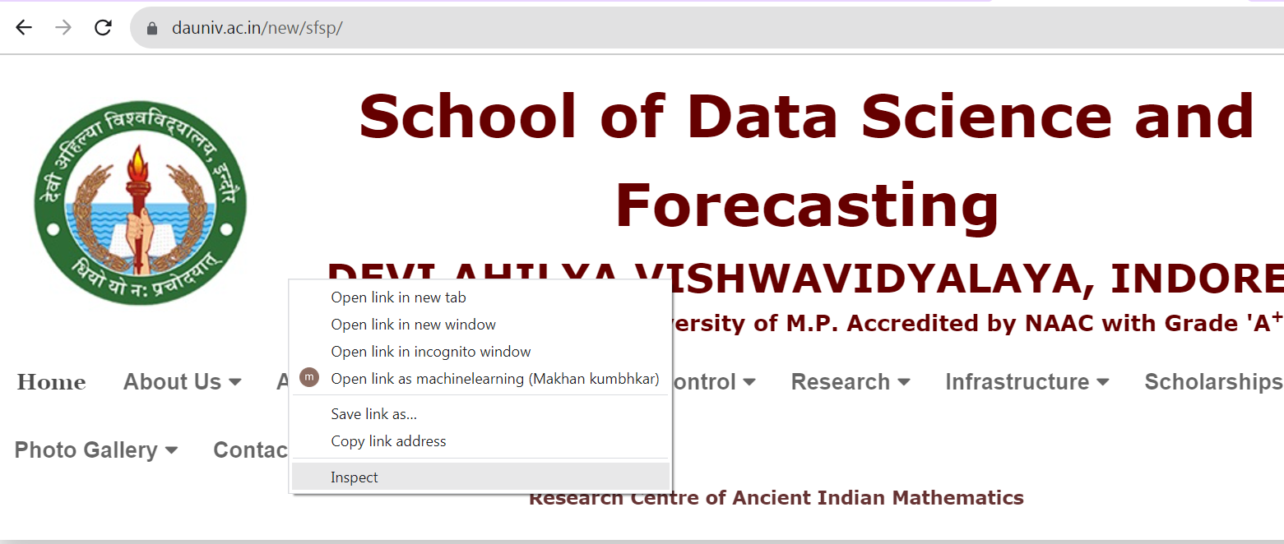
Inspecting Website
Before getting out any information from the HTML of the page, we must understand the structure of the page. This is needed to be done in order to select the desired data from the entire page. We can do this by right-clicking on the page we want to scrape and select inspect element.

Slide 7
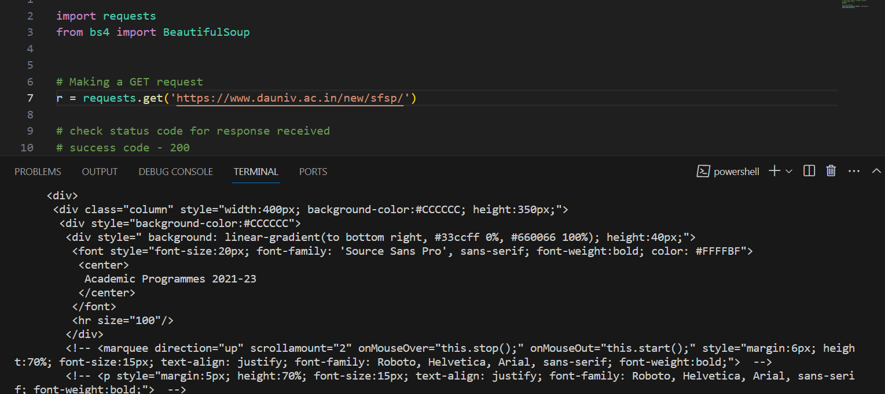
Parsing the HTML
After getting the HTML of the page let’s see how to parse this raw HTML code into some useful information. First of all, we will create a BeautifulSoup object by specifying the parser we want to use.
Note: BeautifulSoup library is built on top of the HTML parsing libraries like html5lib, lxml, html.parser, etc. So BeautifulSoup object and specify the parser library can be created at the same time.

Slide 8
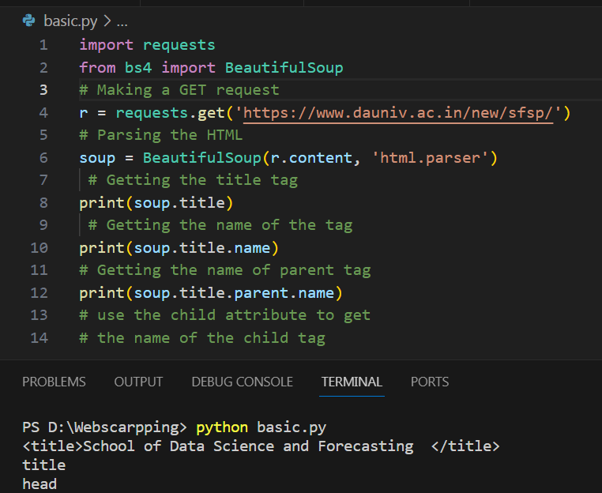
Extract the title of the page

Slide 9
Finding Elements
Now, we would like to extract some useful data from the HTML content. The soup object contains all the data in the nested structure which could be programmatically extracted. The website we want to scrape contains a lot of text so now let’s scrape all those content. First, let’s inspect the webpage we want to scrape.

Slide 10
Web Scrapping

Slide 11
Web Scrapping

Slide 12
Web Scrapping

Slide 13
Web Scrapping

Slide 14
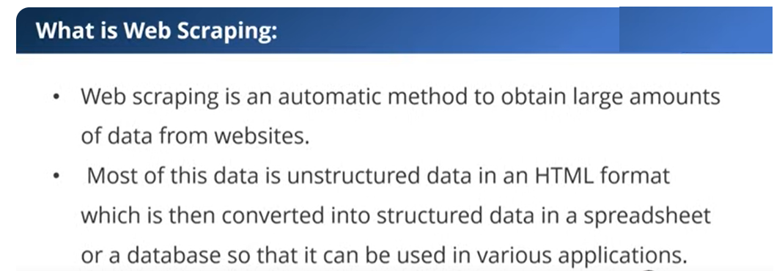
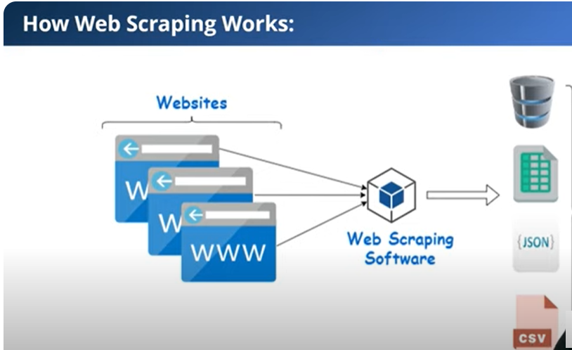
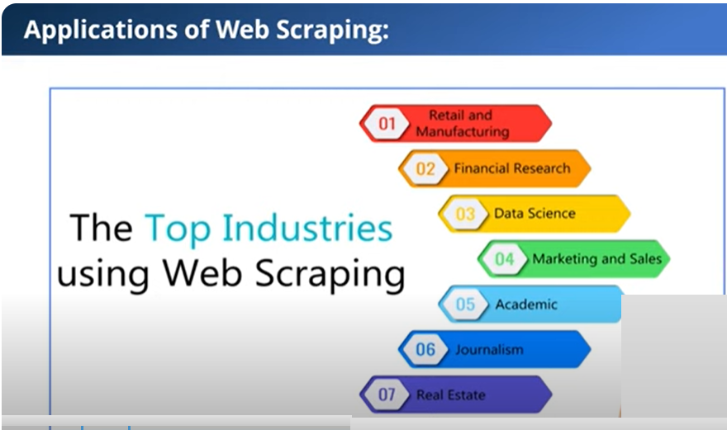

Slide 15
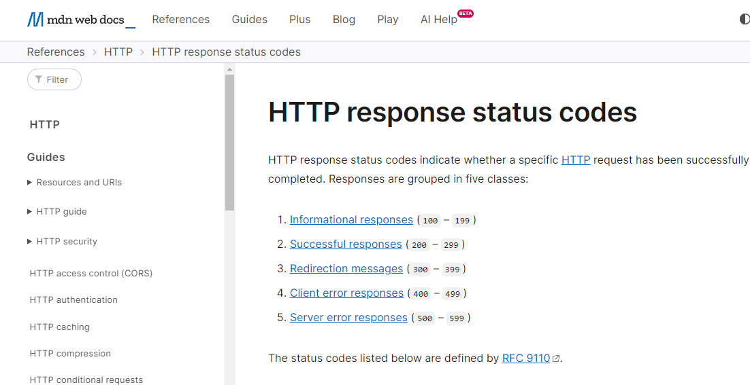
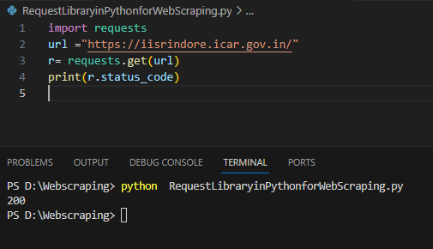
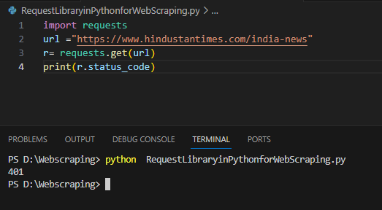
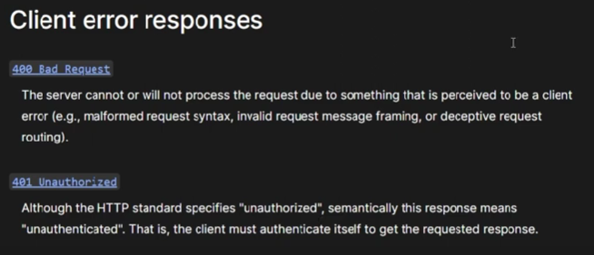
Web Scrapping
https://developer.mozilla.org/en-US/docs/Web/HTTP/Status

Slide 16
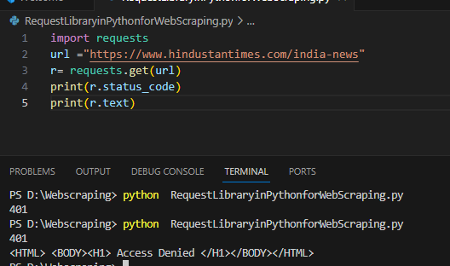
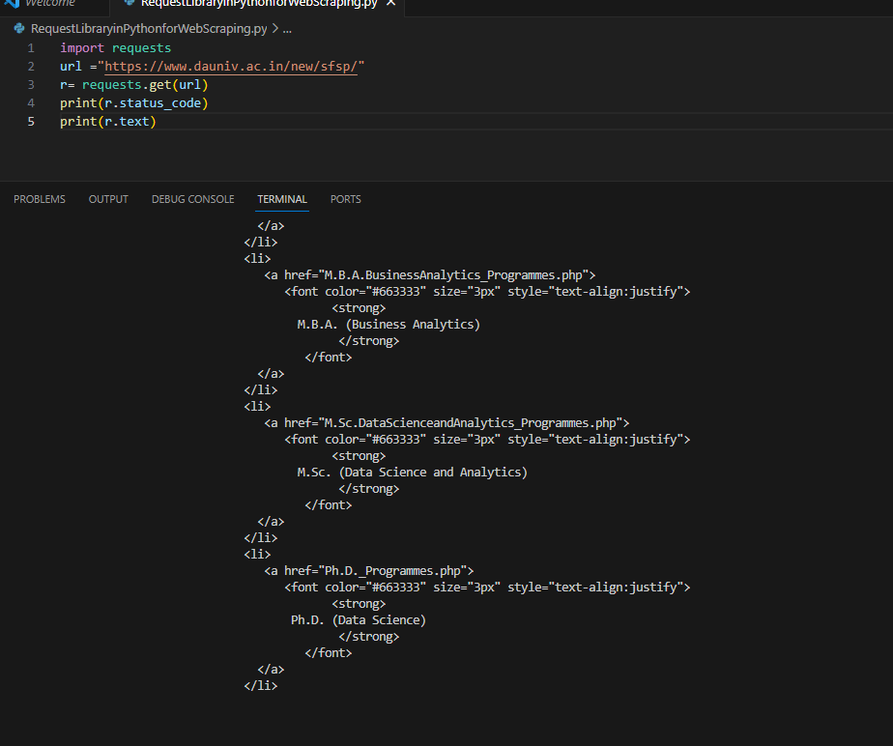
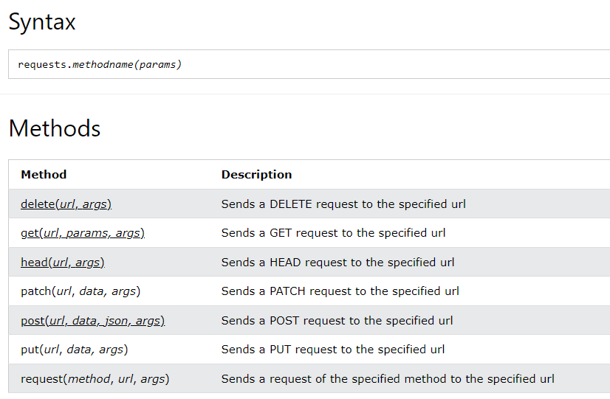
Print HTML
Example
Make a request to a web page, and print the response text:

Slide 17
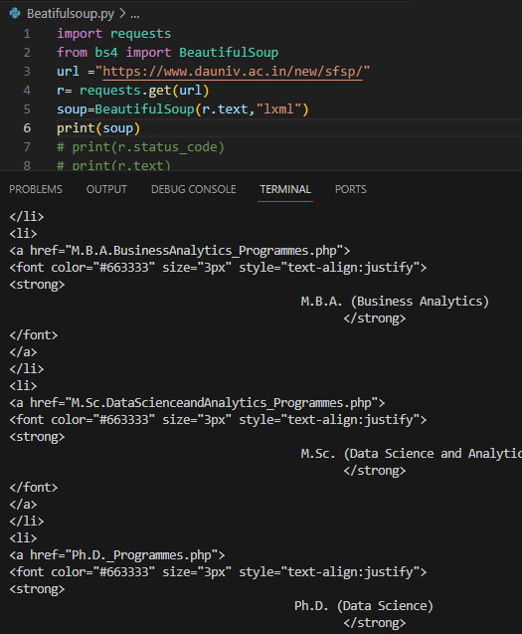
How obtain HTML using BeautifulSoup

Slide 18
Different tested template for webscraping
https://webscraper.io/test-sites/e-commerce/allinone/computers

Slide 19
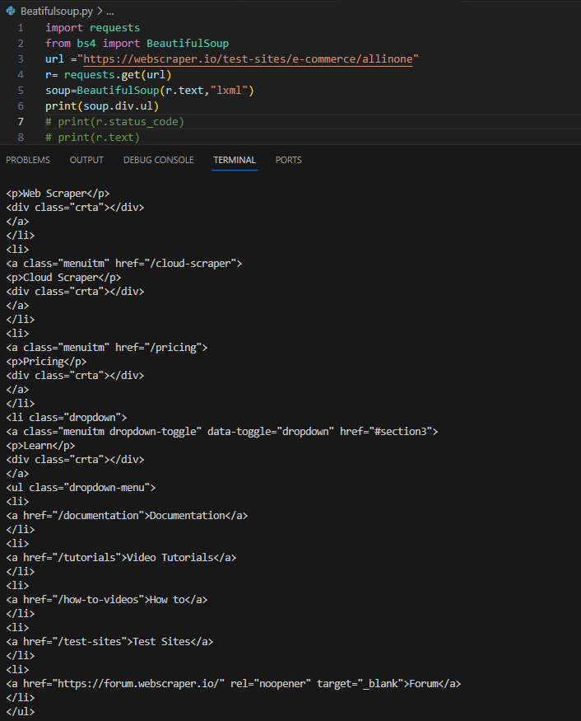
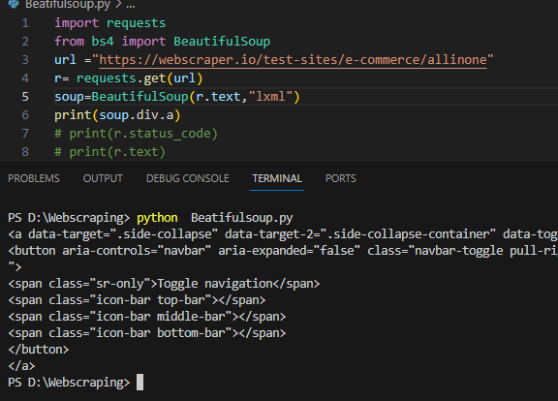
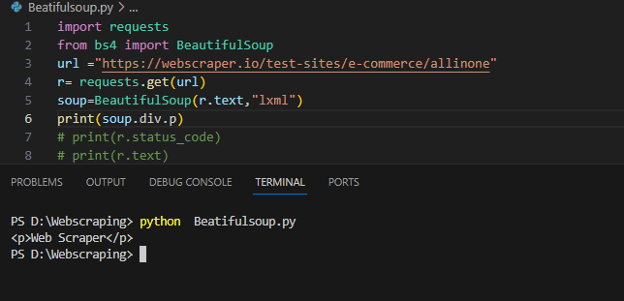
How to see attributes

Slide 20
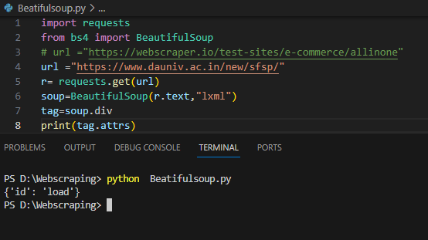
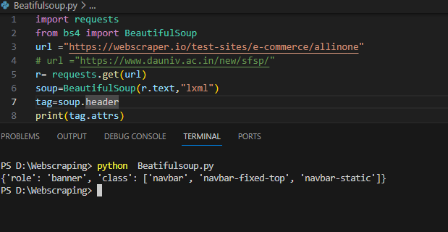
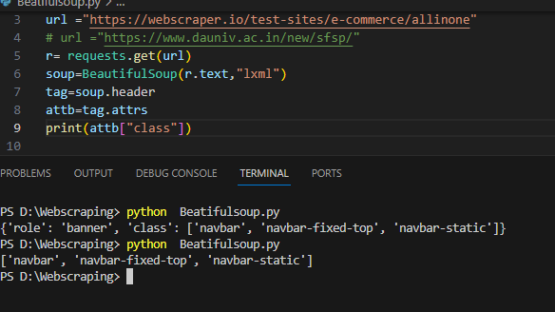
how to get attributes inside tag

Slide 21
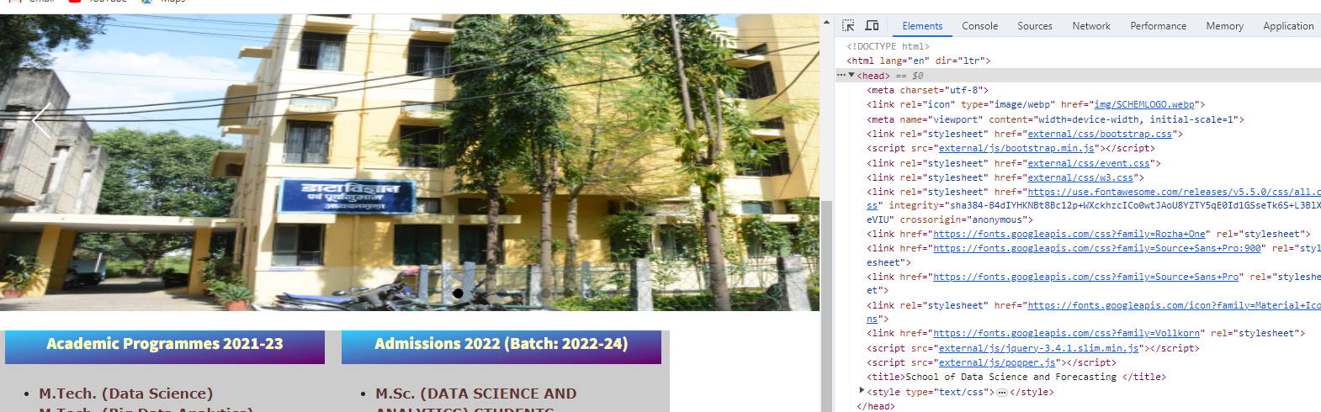
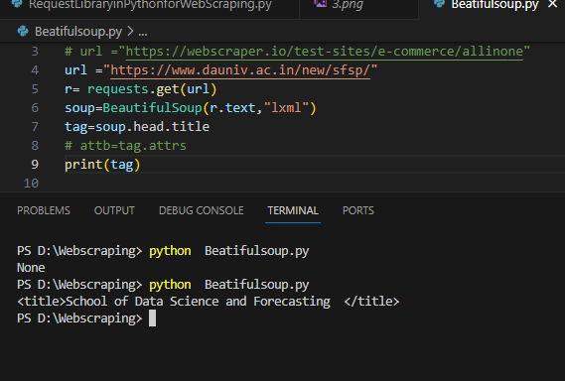



Navigation string in the HTML
A Navigable string object holds the text within an HTML or an XML tag.

Slide 22
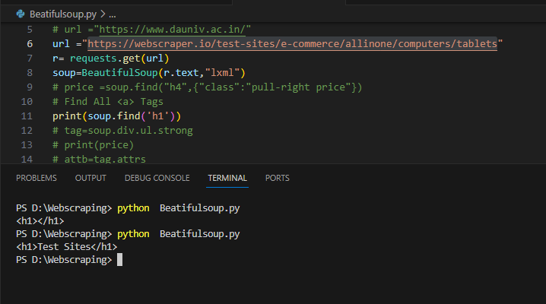
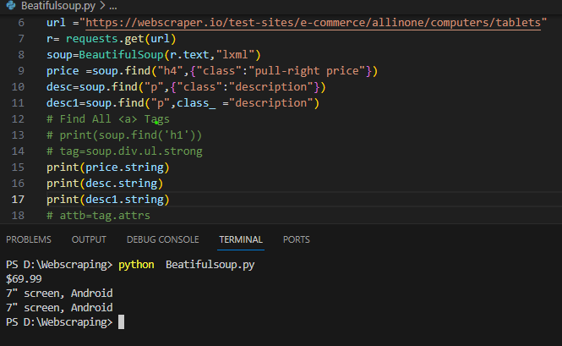
BeautifulSoup .find() Method
We should use the .find() method when there is only one element that matches our query criteria, or just want the first element.
The .find() returns the first element that matches your query criteria.
https://webscraper.io/test-sites/e-commerce/allinone/computers/tablets

Slide 23
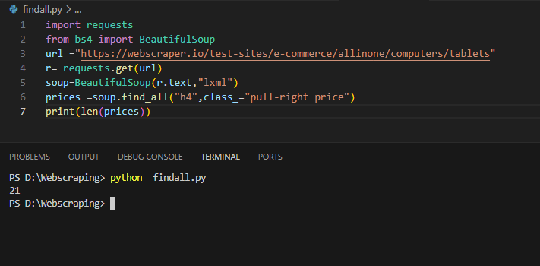
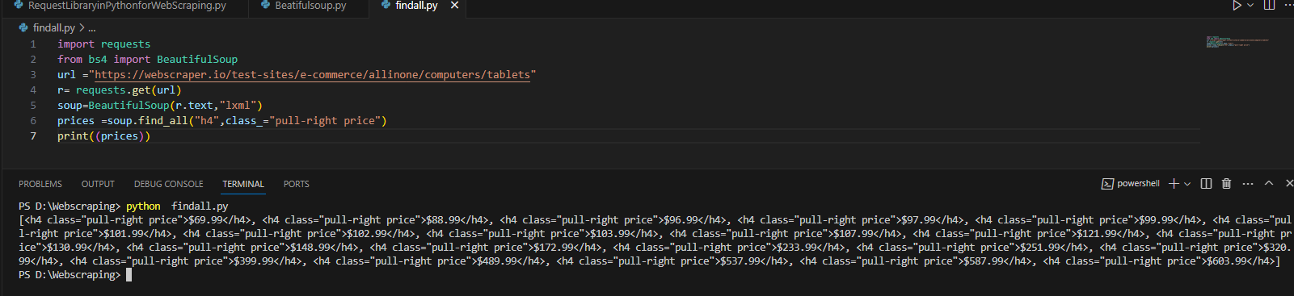
Find_all method with tag
Beautiful Soup's find_all() method returns a list of all the tags or strings that match a particular criteria.
https://webscraper.io/test-sites/e-commerce/allinone/computers/tablets

Slide 24
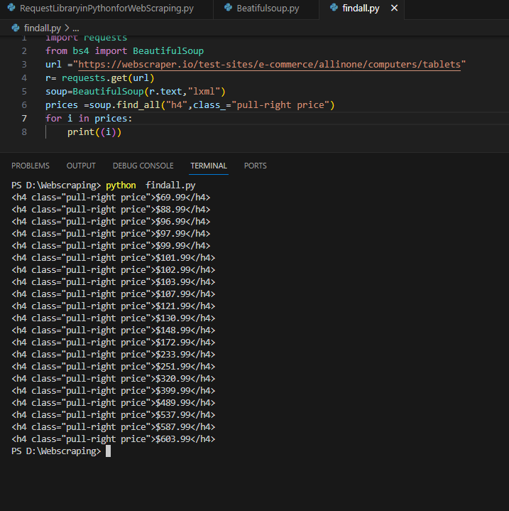
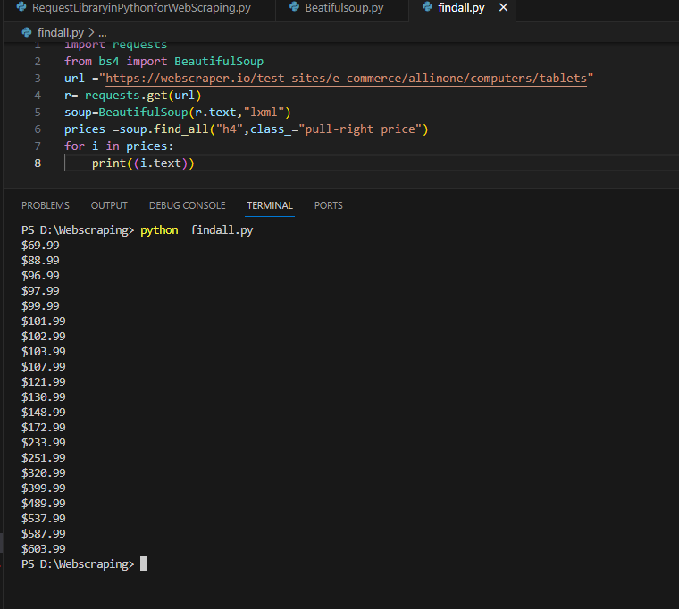
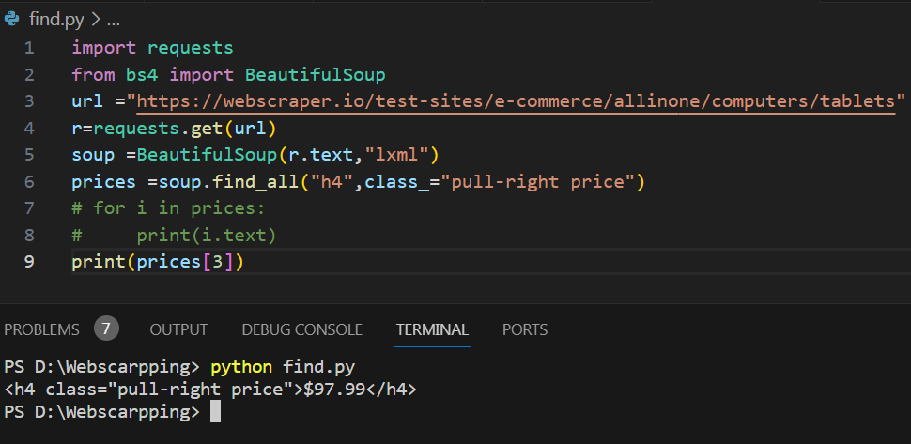
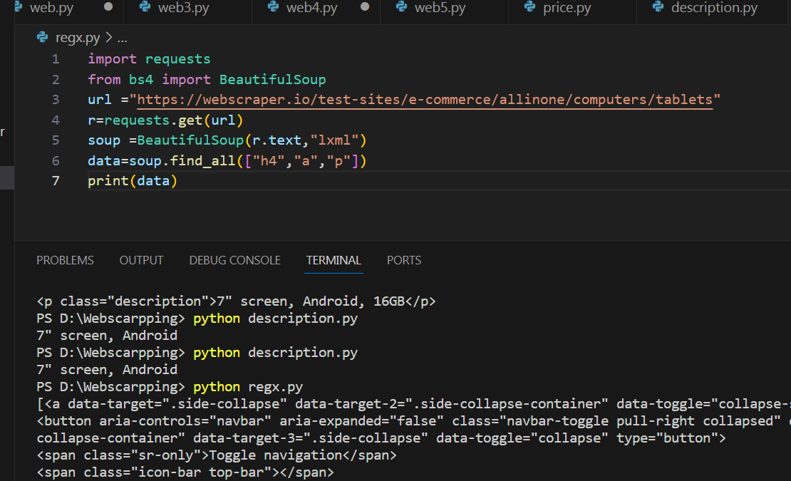

Slide 25
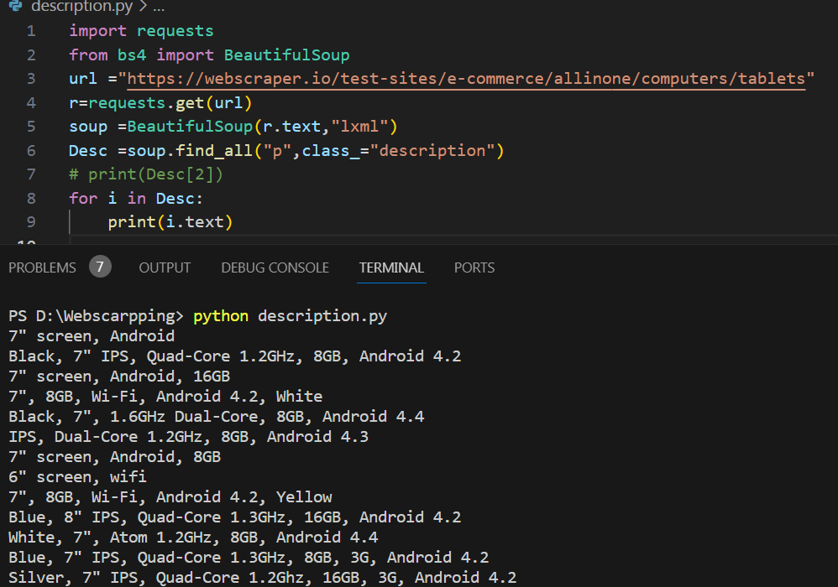

Slide 26
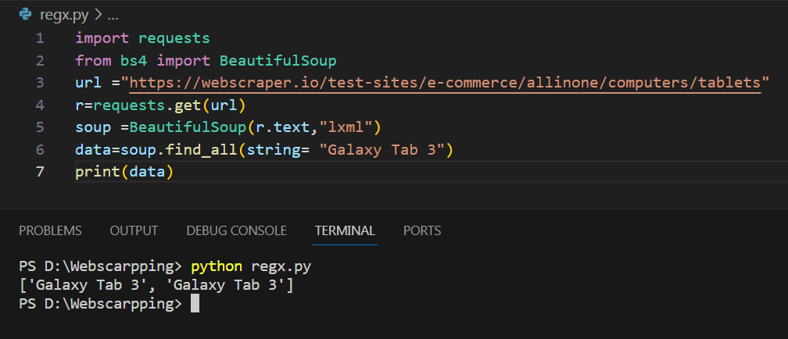
Search with String

Slide 27
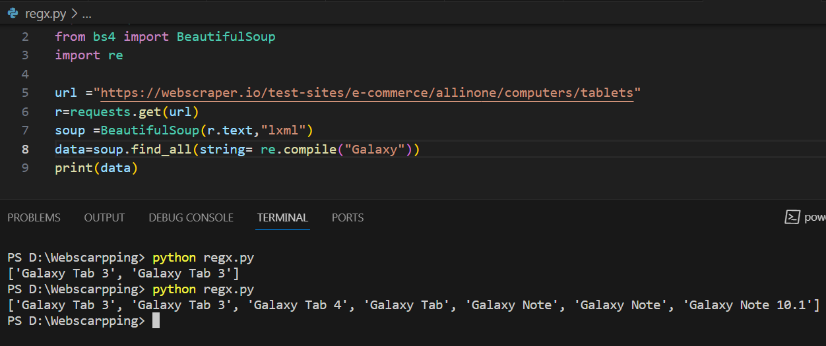
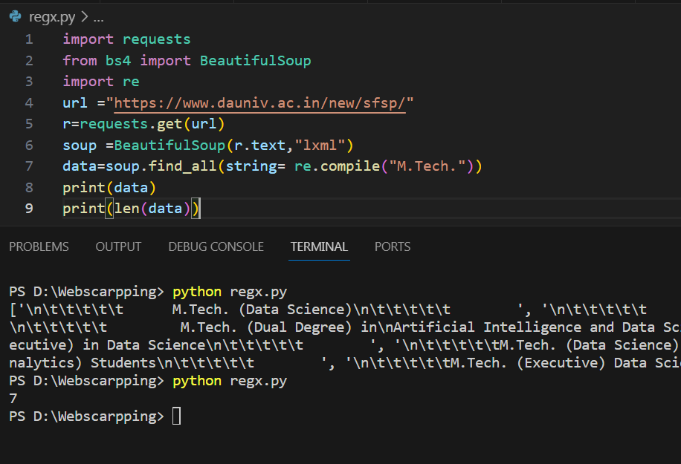
Beautifulsoup -Find_all() with RegEx

Slide 28
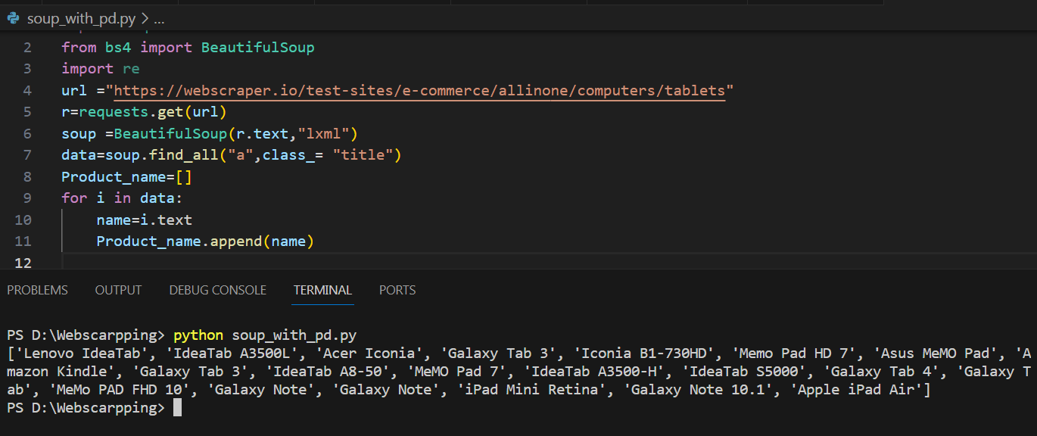
Web Scraping with Beautiful Soup and Pandas
We scrapped all the data of Product name, Description and review form given link

Slide 29
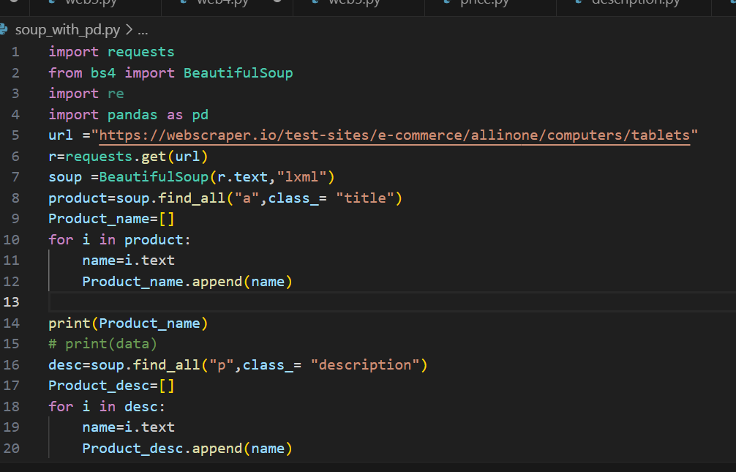
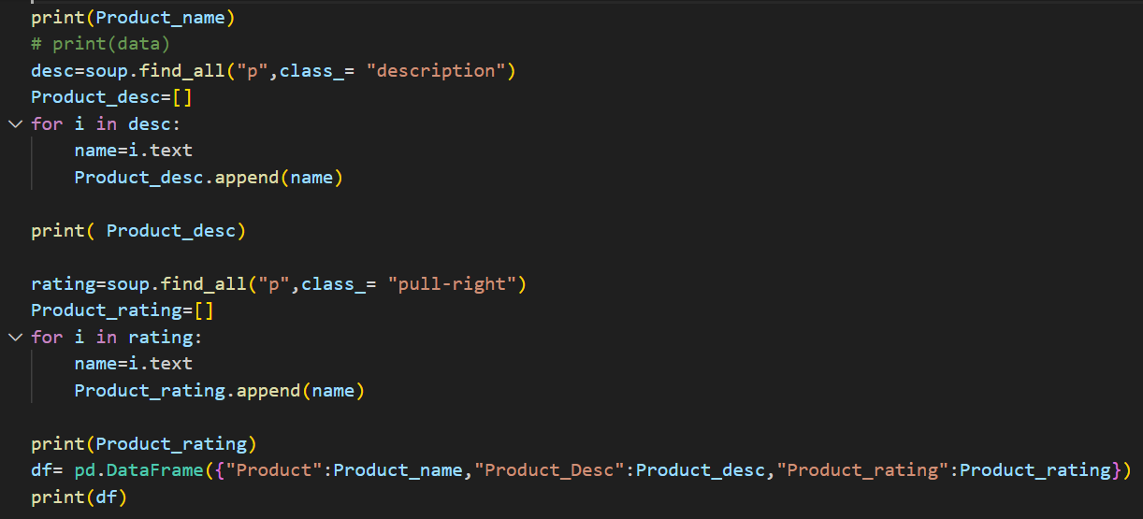
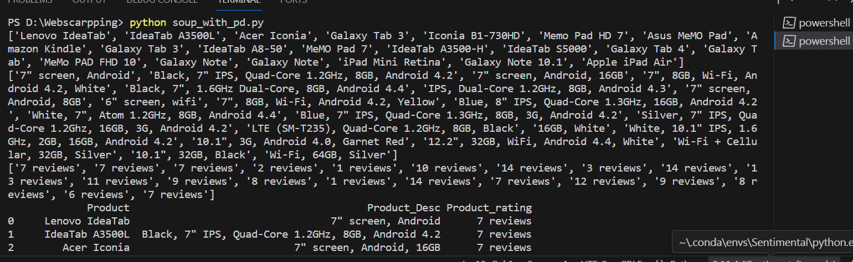

Slide 30
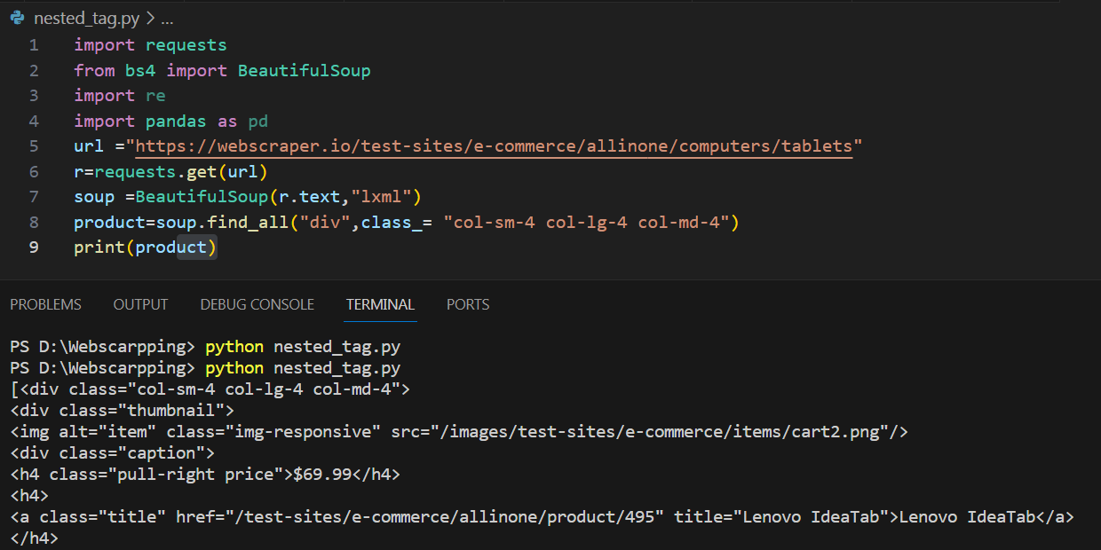
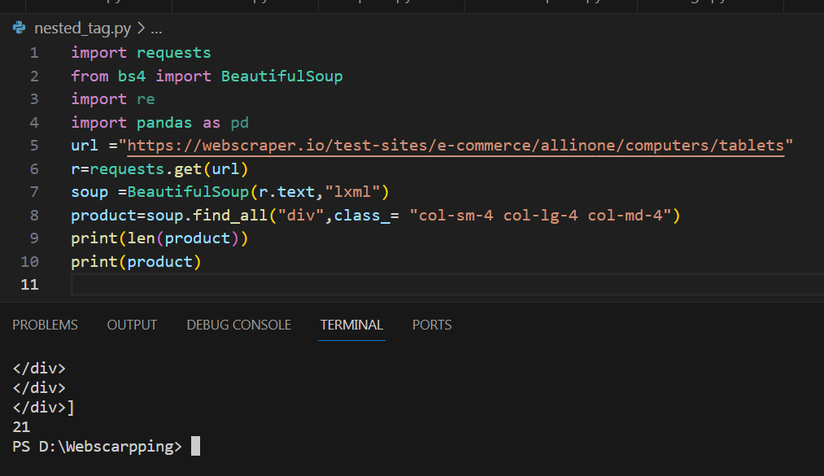
Extract Data from Nested HTML Tags

Slide 31
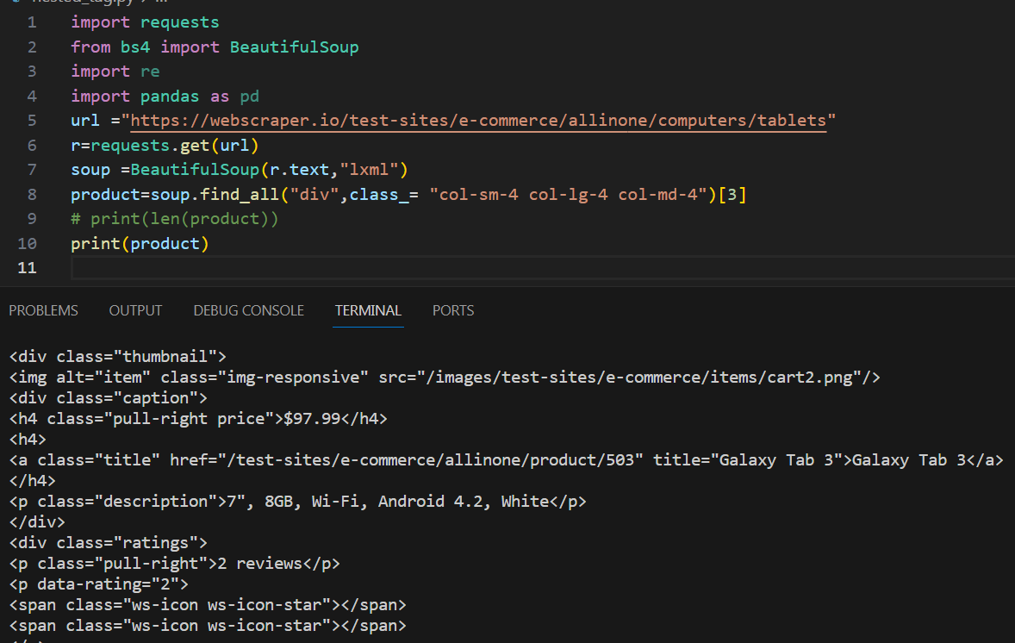
Extract particular Data from Nested HTML Tags

Slide 32
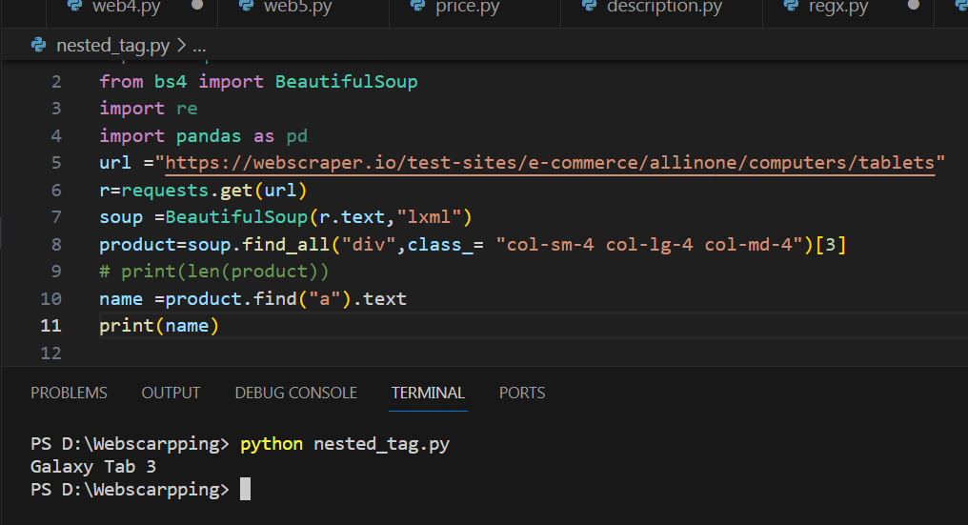
Print Particular name

Slide 33
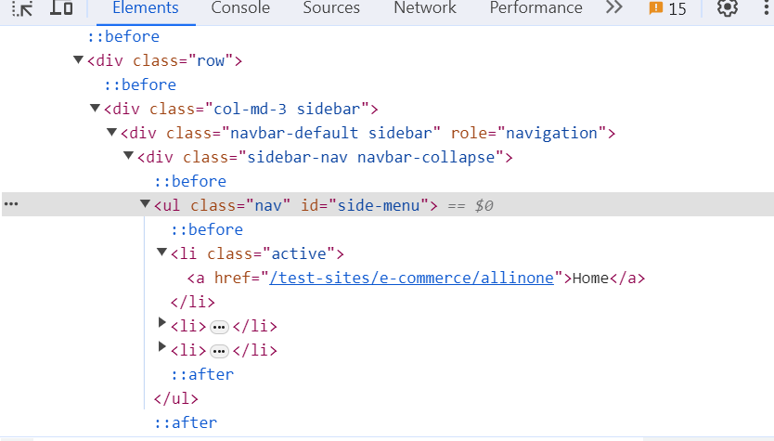
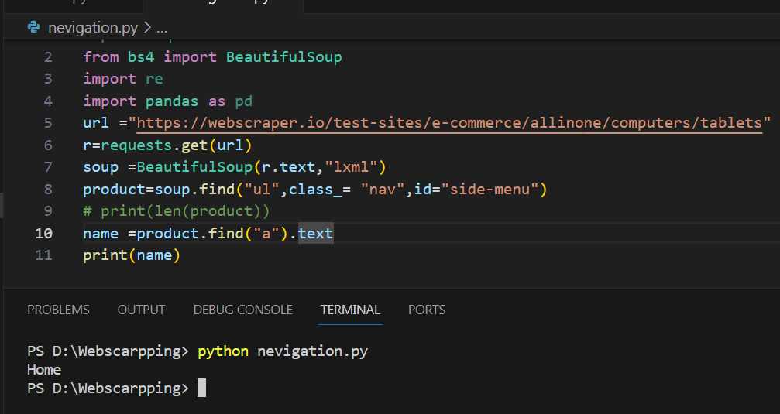
Web Scrapping

Slide 34
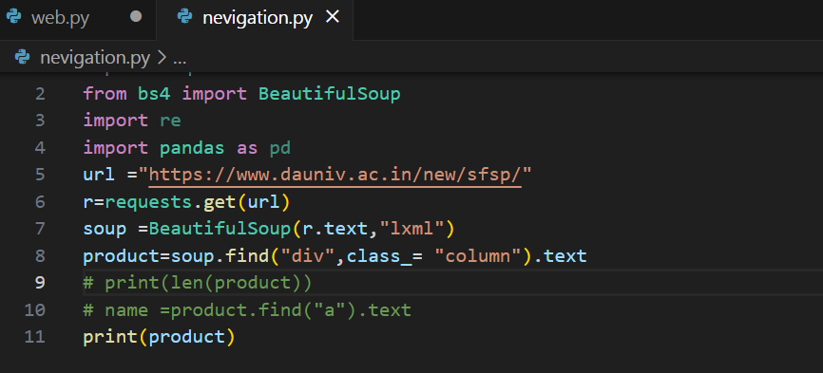
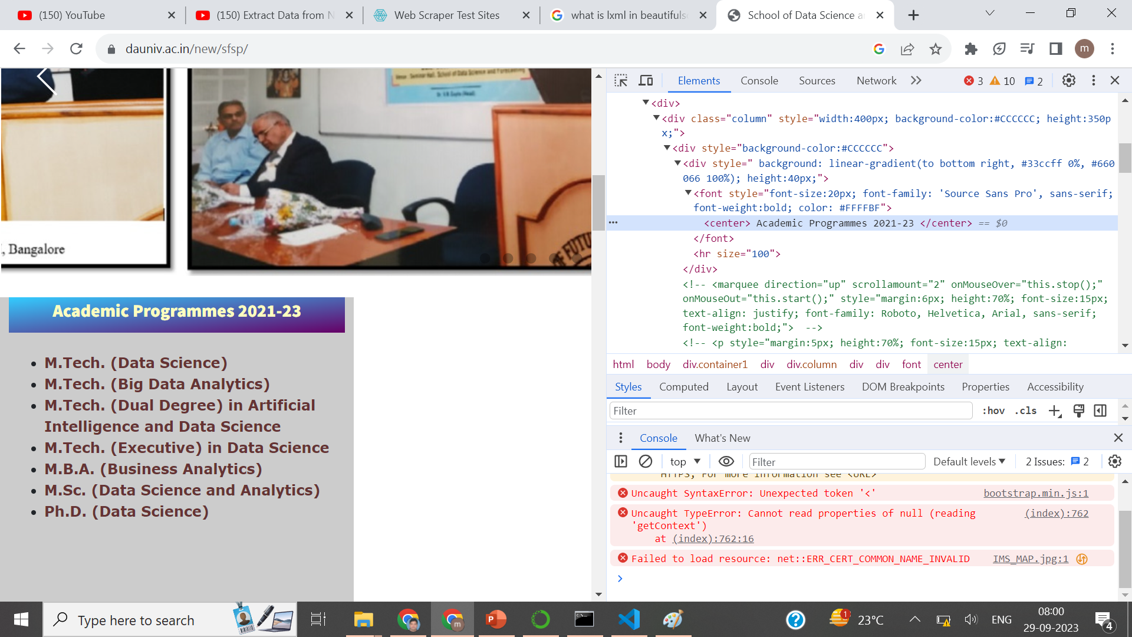

Slide 35
Web Scrapping

Slide 36
Web Scrapping

Slide 37
Web Scrapping

Slide 38
Web Scrapping

Slide 39
Web Scrapping

Slide 40
Web Scrapping

Slide 41
Web Scrapping

Slide 42
Web Scrapping

Slide 43
Web Scrapping

Slide 44
Web Scrapping

Slide 45
Web Scrapping

Slide 46
Web Scrapping

Slide 47
Web Scrapping

Slide 48
Web Scrapping

Slide 49
Web Scrapping

Slide 50
Web Scrapping

Slide 51
Web Scrapping

Slide 52
Web Scrapping

Slide 53
Web Scrapping

Slide 54
Web Scrapping

Slide 55
Web Scrapping

Slide 56
Web Scrapping

Slide 57
Web Scrapping

Slide 58
Web Scrapping

Slide 59
Web Scrapping

Slide 60
Web Scrapping

Slide 61
Web Scrapping

